Slide 1

15CSE313 Software Engineering
Lecture 2-3

Slide 2
Introduction to Software Engineering
Pressman R S, Bruce R.Maxim, “Software engineering - A Practitioner’s Approach”, Eighth Edition, Tata McGraw-Hill, 2014
Chapter 1: 1.1, 1.2
Chapter 2: 2.1, 2.2

Slide 3
Topics Covered
Topic | Text Book Reference
Introduction | Chapter 1
Nature of Software | 1.1
The Changing Nature of Software | 1.2
Software Engineering Definition | Chapter 2.1
The Software Process | 2.2

Slide 4
Introduction
Computer software continues to be the single most important technology on the world stage
Sixty years ago no one could have predicted that software would become an indispensable technology for business, science, and engineering
No one could predict that millions of computer programs would have to be corrected, adapted, and enhanced as time passed. The burden of performing these “maintenance” activities would absorb more people and more resources than all work applied to the creation of new software.

Slide 5

Why software Development projects fail?
Poor Communication
Not reviewing project progress on a regular basis
Unclear requirements
Unrealistic expectations
Internal Communication
External Communication
We will have periodic reviews ☺
Remember your DBMS project → What was the original project topic and what you end up doing? :P
Clients will always want their project delivered yesterday, at the lowest cost and highest quality. You don’t want to disappoint, so you assure them that everything is possible, including delivering yesterday.

Slide 6
Why software Development projects fail?
The absence of a good project manager
Better have a good manager in your project team
Not investing enough time for the project
Spend quality time for the project → It will definitely help
No end user involvement
Better talk to me more often ☺
Lack of quality testing
Testing is as important as development

Slide 7
What is Software ?
Software can be defined as:
Instruction – executed provide desire features, function & performance.
Data structure – to adequately manipulate operation.
Documents – operation and use of the program.
Software products may be developed for a particular customer or may be developed for a general market.
Software products may be
Generic - developed to be sold to a range of different customers e.g. PC software such as Excel or Word.
Bespoke (custom) - developed for a single customer according to their specification.

Slide 8
Evolving Role of Software
Software is a product
Transforms information - produces, manages, acquires, modifies, displays, or transmits information
Delivers computing potential of hardware and networks
Software is a vehicle for delivering a product
Controls other programs (operating system)
Effects communications (networking software)
Helps build other software (software tools & environments)

Slide 9
Software characteristics Differences with hardware
Software is developed or engineered; it is not manufactured
Software does not “wear out” but it does deteriorate
Software continues to be custom built, as industry is moving toward component based construction

Slide 10
Manufacturing vs. Development
Once a hardware product has been manufactured, it is difficult or impossible to modify. In contrast, software products are routinely modified and upgraded
In hardware, hiring more people allows you to accomplish more work, but the same does not necessarily hold true in software engineering
Unlike hardware, software costs are concentrated in design rather than production.

Slide 11
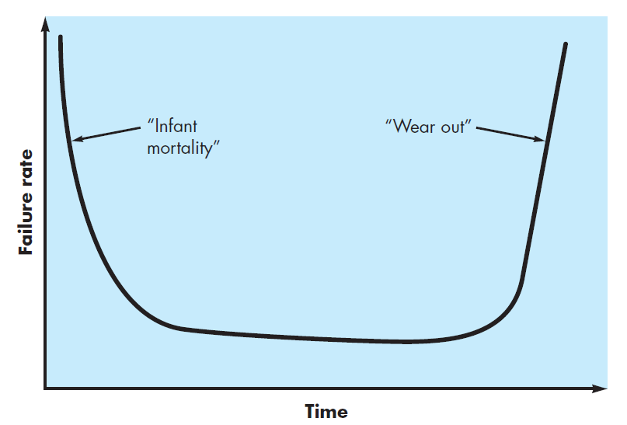
Failure curve for Hardware

Slide 12
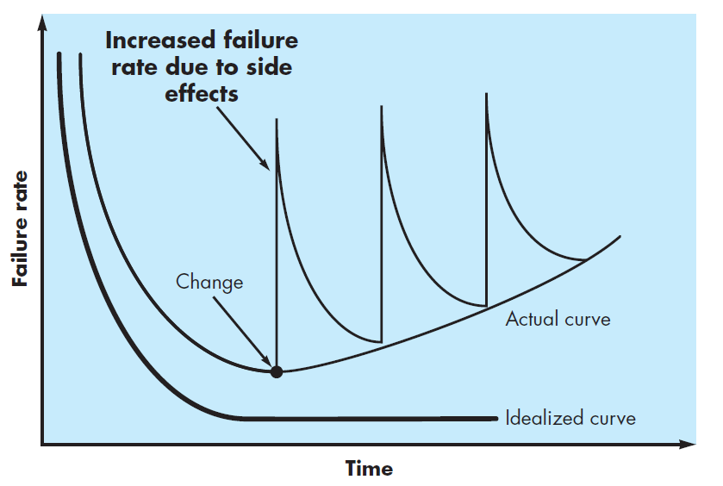
Failure curve for Software
When a hardware component wears out, it is replaced by a spare part.
There are no software spare parts. Every software failure indicates an error in design or in the process through which design was translated into machine executable code. Therefore, software maintenance involves considerably more complexity

Slide 13
Component Based vs. Custom Built
Hardware products typically employ many standardized design components.
Most software continues to be custom built.
The software industry does seem to be moving (slowly) toward component-based construction.

Slide 14
Hardware vs. Software
Hardware | Software
Manufactured wear out Built using components Relatively simple | Developed/ engineered deteriorate Custom built Complex

Slide 15
Nature of softWare

Slide 16
Changing nature of software
System software
Application software
Engineering/scientific software
Embedded software
Product line software
Web/mobile applications
Artificial intelligence software

Slide 17
Software Application Domains
System Software:
System software is a collection of programs written to service other programs.
It is characterized by heavy interaction with computer hardware; heavy usage by multiple users; concurrent operation that requires scheduling, resource sharing, and sophisticated process management; complex data structures; and multiple external interfaces.
Application Software :
Application software consists of standalone programs that solve a specific business need.
Application software is used to control the business function in real-time
Ex. Compilers, operating system, drivers etc.

Slide 18
Software Application Domains
Engineering /Scientific software:
Characterized by "number crunching" algorithms. Applications range from astronomy to volcano logy, from automotive stress analysis to space shuttle orbital dynamics, and from molecular biology to automated manufacturing. Ex. Computer Aided Design (CAD), system stimulation etc.
Embedded Software:
It resides in read-only memory and is used to control products and systems. Embedded software can perform limited and esoteric functions. Ex. keypad control for a microwave oven.
Product line software:
Designed to provide a specific capability for use by many different customers, product line software can focus on a limited and esoteric marketplace. Ex. Word processing, spreadsheet, CG, multimedia, etc.

Slide 19
Software Application Domains
Web/mobile Applications:
Web/mobile apps can be little more than a set of linked hypertext files. It is evolving into sophisticated computing environments that not only provide standalone features, functions but also integrated with corporate database and business applications.
Artificial Intelligence software
AI software makes use of non-numerical algorithms to solve complex problems that are not amenable to computation or straightforward analysis
Ex. Robotics, expert system, game playing, etc.

Slide 20
THE CHANGING NATURE OF SOFTWARE
Four broad categories of software are evolving to dominate the industry

Slide 21
The Changing Nature of Software
Web Apps
Mobile Apps
Cloud Computing
Product Line software

Slide 22
Web Apps
WebApps have evolved into sophisticated computing tools that not only provide stand-alone function to the end user, but also have been integrated with corporate databases and business applications
Today, they provide full computing potential in many of the application categories
Over the past decade, Semantic Web technologies (often referred to as Web 3.0) have evolved into sophisticated corporate and consumer applications that encompass “semantic databases [that] provide new functionality that requires Web linking, flexible [data] representation, and external access APIs.”
Sophisticated relational data structures will lead to entirely new WebApps that allow access to disparate information in ways never before possible.

Slide 23
Mobile Apps
The term app has evolved to connote software that has been specifically designed to reside on a mobile platform
In most instances, mobile applications encompass a user interface that takes advantage of the unique interaction mechanisms provided by the mobile platform
A mobile app can gain direct access to the hardware characteristics of the device (e.g., accelerometer or GPS location) and then provide the local processing and storage capabilities

Slide 24
Cloud Computing
Cloud computing encompasses an infrastructure or “ecosystem” that enables any user, anywhere, to use a computing device to share computing resources on a broad scale
The implementation of cloud computing requires the development of an architecture that encompasses front-end and back-end services.
The front-end includes the client (user) device and the application software (e.g., a browser) that allows the back-end to be accessed.
The back-end includes servers and related computing resources, data storage systems (e.g., databases), server-resident applications, and administrative servers that use middleware to coordinate and monitor traffic by establishing a set of protocols for access to the cloud and its resident resources.

Slide 25
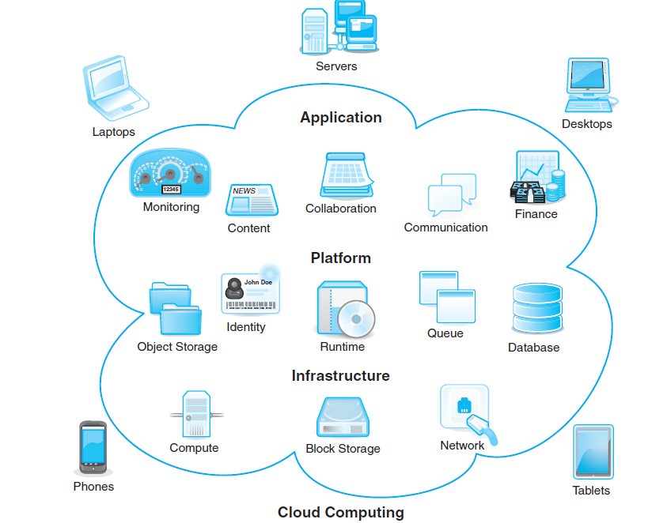
Cloud Computing

Slide 26
Product Line Software
A set of software-intensive systems that share a common, managed set of features satisfying the specific needs of a particular market segment or mission and that are developed from a common set of core assets in a prescribed way
The idea that a line of software products, all developed using the same underlying application and data architectures, and all implemented using a set of reusable software components that can be reused across the product line provides significant engineering leverage

Slide 27
Define Software Engineering

Slide 28
Definition
The IEEE definition for software engineering:
Software Engineering : (1) The application of a systematic, disciplined, quantifiable approach to the development, operation, and maintenance of software; that is, the application of engineering to software.

Slide 29

Software Engineering Layers
Software engineering is a layered technology
Any engineering approach (including software engineering) must rest on an organizational commitment to quality
The bedrock that supports software engineering is a quality focus

Slide 30
Software Engineering Layers
The foundation for software engineering is the process layer
Process defines a framework that must be established for effective delivery of software engineering technology
The software process forms the basis for management control of software projects and establishes the context in which technical methods are applied, work products (models, documents, data, reports, forms, etc.) are produced, milestones are established, quality is ensured, and change is properly managed.

Slide 31
Software Engineering Layers
Software engineering methods provide the technical how-to’s for building software. Methods encompass a broad array of tasks that include communication, requirements analysis, design modeling, program construction, testing, and support
Software engineering methods rely on a set of basic principles that govern each area of the technology and include modeling activities and other descriptive techniques.

Slide 32
Software Engineering Layers
Software engineering tools provide automated or semi-automated support for the process and the methods
When tools are integrated so that information created by one tool can be used by another, a system for the support of software development, called computer-aided software engineering , is established

Slide 33
The Software Process

Slide 34
The Software Process
A process is a collection of activities, actions, and tasks that are performed when some work product is to be created.
An activity strives to achieve a broad objective (e.g., communication with stakeholders) and is applied regardless of the application domain, size of the project, complexity of the effort, or degree of rigor with which software engineering is to be applied
An action (e.g., architectural design) encompasses a set of tasks that produce a major work product (e.g., an architectural model)
A task focuses on a small, but well-defined objective (e.g., conducting a unit test) that produces a tangible outcome.

Slide 35
The Software Process
In the context of software engineering, a process is not a rigid prescription for how to build computer software
Rather, it is an adaptable approach that enables the people doing the work (the software team) to pick and choose the appropriate set of work actions and tasks
The intent is always to deliver software in a timely manner and with sufficient quality to satisfy those who have sponsored its creation and those who will use it

Slide 36
The Process framework
A process framework establishes the foundation for a complete software engineering process by identifying a small number of framework activities that are applicable to all software projects, regardless of their size or complexity.
In addition, the process framework encompasses a set of umbrella activities that are applicable across the entire software process

Slide 37
The Process framework A generic process framework for software engineering encompasses five activities
Communication
Before any technical work can commence, it is critically important to communicate and collaborate with the customer (and other stakeholders)
Planning
Software project plan—defines the software engineering work by describing the technical tasks to be conducted, the risks that are likely, the resources that will be required, the work products to be produced, and a work schedule
Modeling
Create a “sketch” of the thing so that you’ll understand the big picture, what it will look like architecturally, how the constituent parts fi t together, and many other characteristics
The intent is to understand stakeholders’ objectives for the project and to gather requirements that help define software features and functions

Slide 38
The Process framework A generic process framework for software engineering encompasses five activities
Deployment
Construction
What you design must be built. This activity combines code generation (either manual or automated) and the testing that is required to uncover errors in the code
The software (as a complete entity or as a partially completed increment) is delivered to the customer who evaluates the delivered product and provides feedback based on the evaluation

Slide 39
Umbrella activities in software engineering
In general, umbrella activities are applied throughout a software project and help a software team manage and control progress, quality, change, and risk
Typical umbrella activities include
Software project tracking and control
Risk Management
Software Quality Assurance
Technical Reviews
Measurement
Software Configuration Management
Reusability management
Work product preparation and Management

Slide 40
Process Adaptation
Previously we said that the software engineering process is not a rigid prescription that must be followed dogmatically by a software team
Rather, it should be agile and adaptable (to the problem, to the project, to the team, and to the organizational culture)
Therefore, a process adopted for one project might be significantly different than a process adopted for another project

Slide 41
Some differences
Overall flow of activities, actions, and tasks and the interdependencies among them
Degree to which actions and tasks are defined within each framework activity.
Degree to which work products are identified and required
Manner in which quality assurance activities are applied.
Manner in which project tracking and control activities are applied.
Overall degree of detail and rigor with which the process is described.
Degree to which the customer and other stakeholders are involved with the project
Level of autonomy given to the software team.
Degree to which team organization and roles are prescribed

Slide 42
Question
Consider the seven software categories. Do you think that the same approach to software engineering can be applied for each? Explain your answer.
System software
Application software
Engineering/scientific software
Embedded software
Product line software
Web/mobile applications
Artificial intelligence software

Slide 43
Summary
Software is the key element in the evolution of computer-based systems and products and one of the most important technologies on the world stage
The nature of software is changing → Web, Mobile, Cloud …
Software engineering encompasses process, methods, and tools that enable complex computer-based systems to be built in a timely manner with quality
The software process incorporates five framework activities — communication, planning, modeling, construction, and deployment—that are applicable to all software projects
Software engineering practice is a problem-solving activity that follows a set of core principles

